Slide 1
Pothole Panic
Carolyn Nahikian

Slide 2
Summary
Pothole Panic is an endless runner game based on a car avoiding potholes
The goal of this game is to steer the car to avoid the incoming potholes
The speed of the potholes increases as the game progresses

Slide 3
Overview of Elements
ST7789 LCD displays the game being played
Car moves left and right based on the accelerometer x-axis data from the BMI160
Potholes move down towards the car in 5 columns with up to 2 at a time
The score is measured based on the number of potholes avoided
The high score is saved in the Tiva C’s EEPROM and can be reset with the correct combination of buttons pressed
The buttons are used for player customization and starting/restarting the game

Slide 4
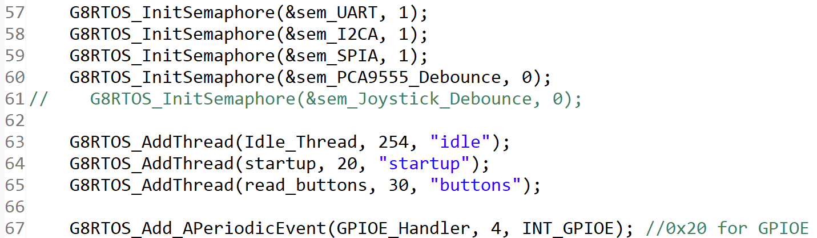
RTOS Components
Aperiodic Threads:
GPIOE Handler
Pothole 2
Pothole 3
Start Game
Lose Condition
Read Buttons
Threads:
Idle
Startup
Background
New High Score
Car
Semaphores:
UART
I2C A
SPI A
PCA9555 Debounce

Slide 5
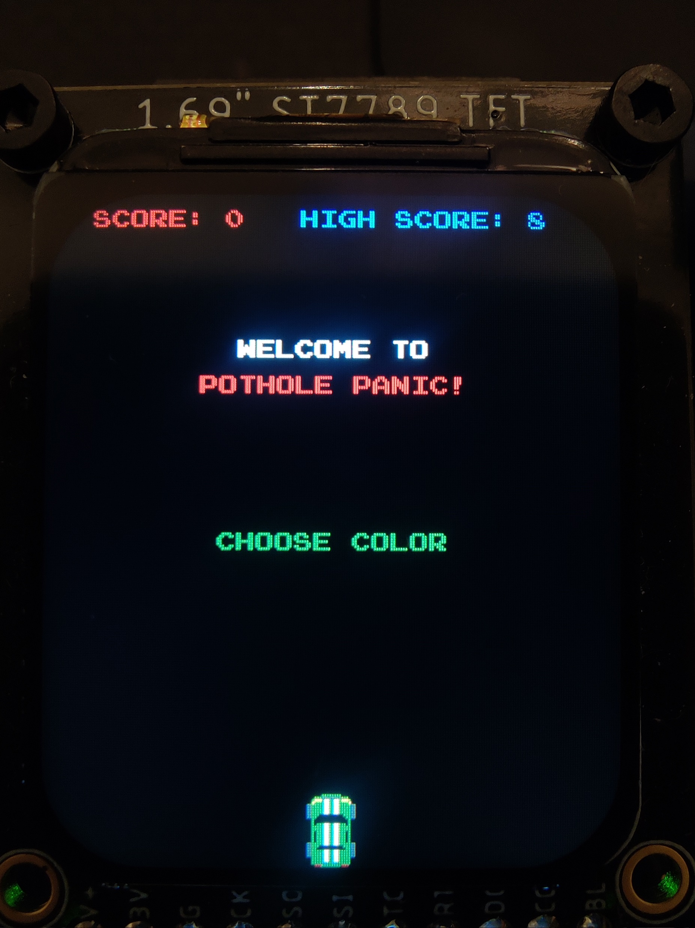
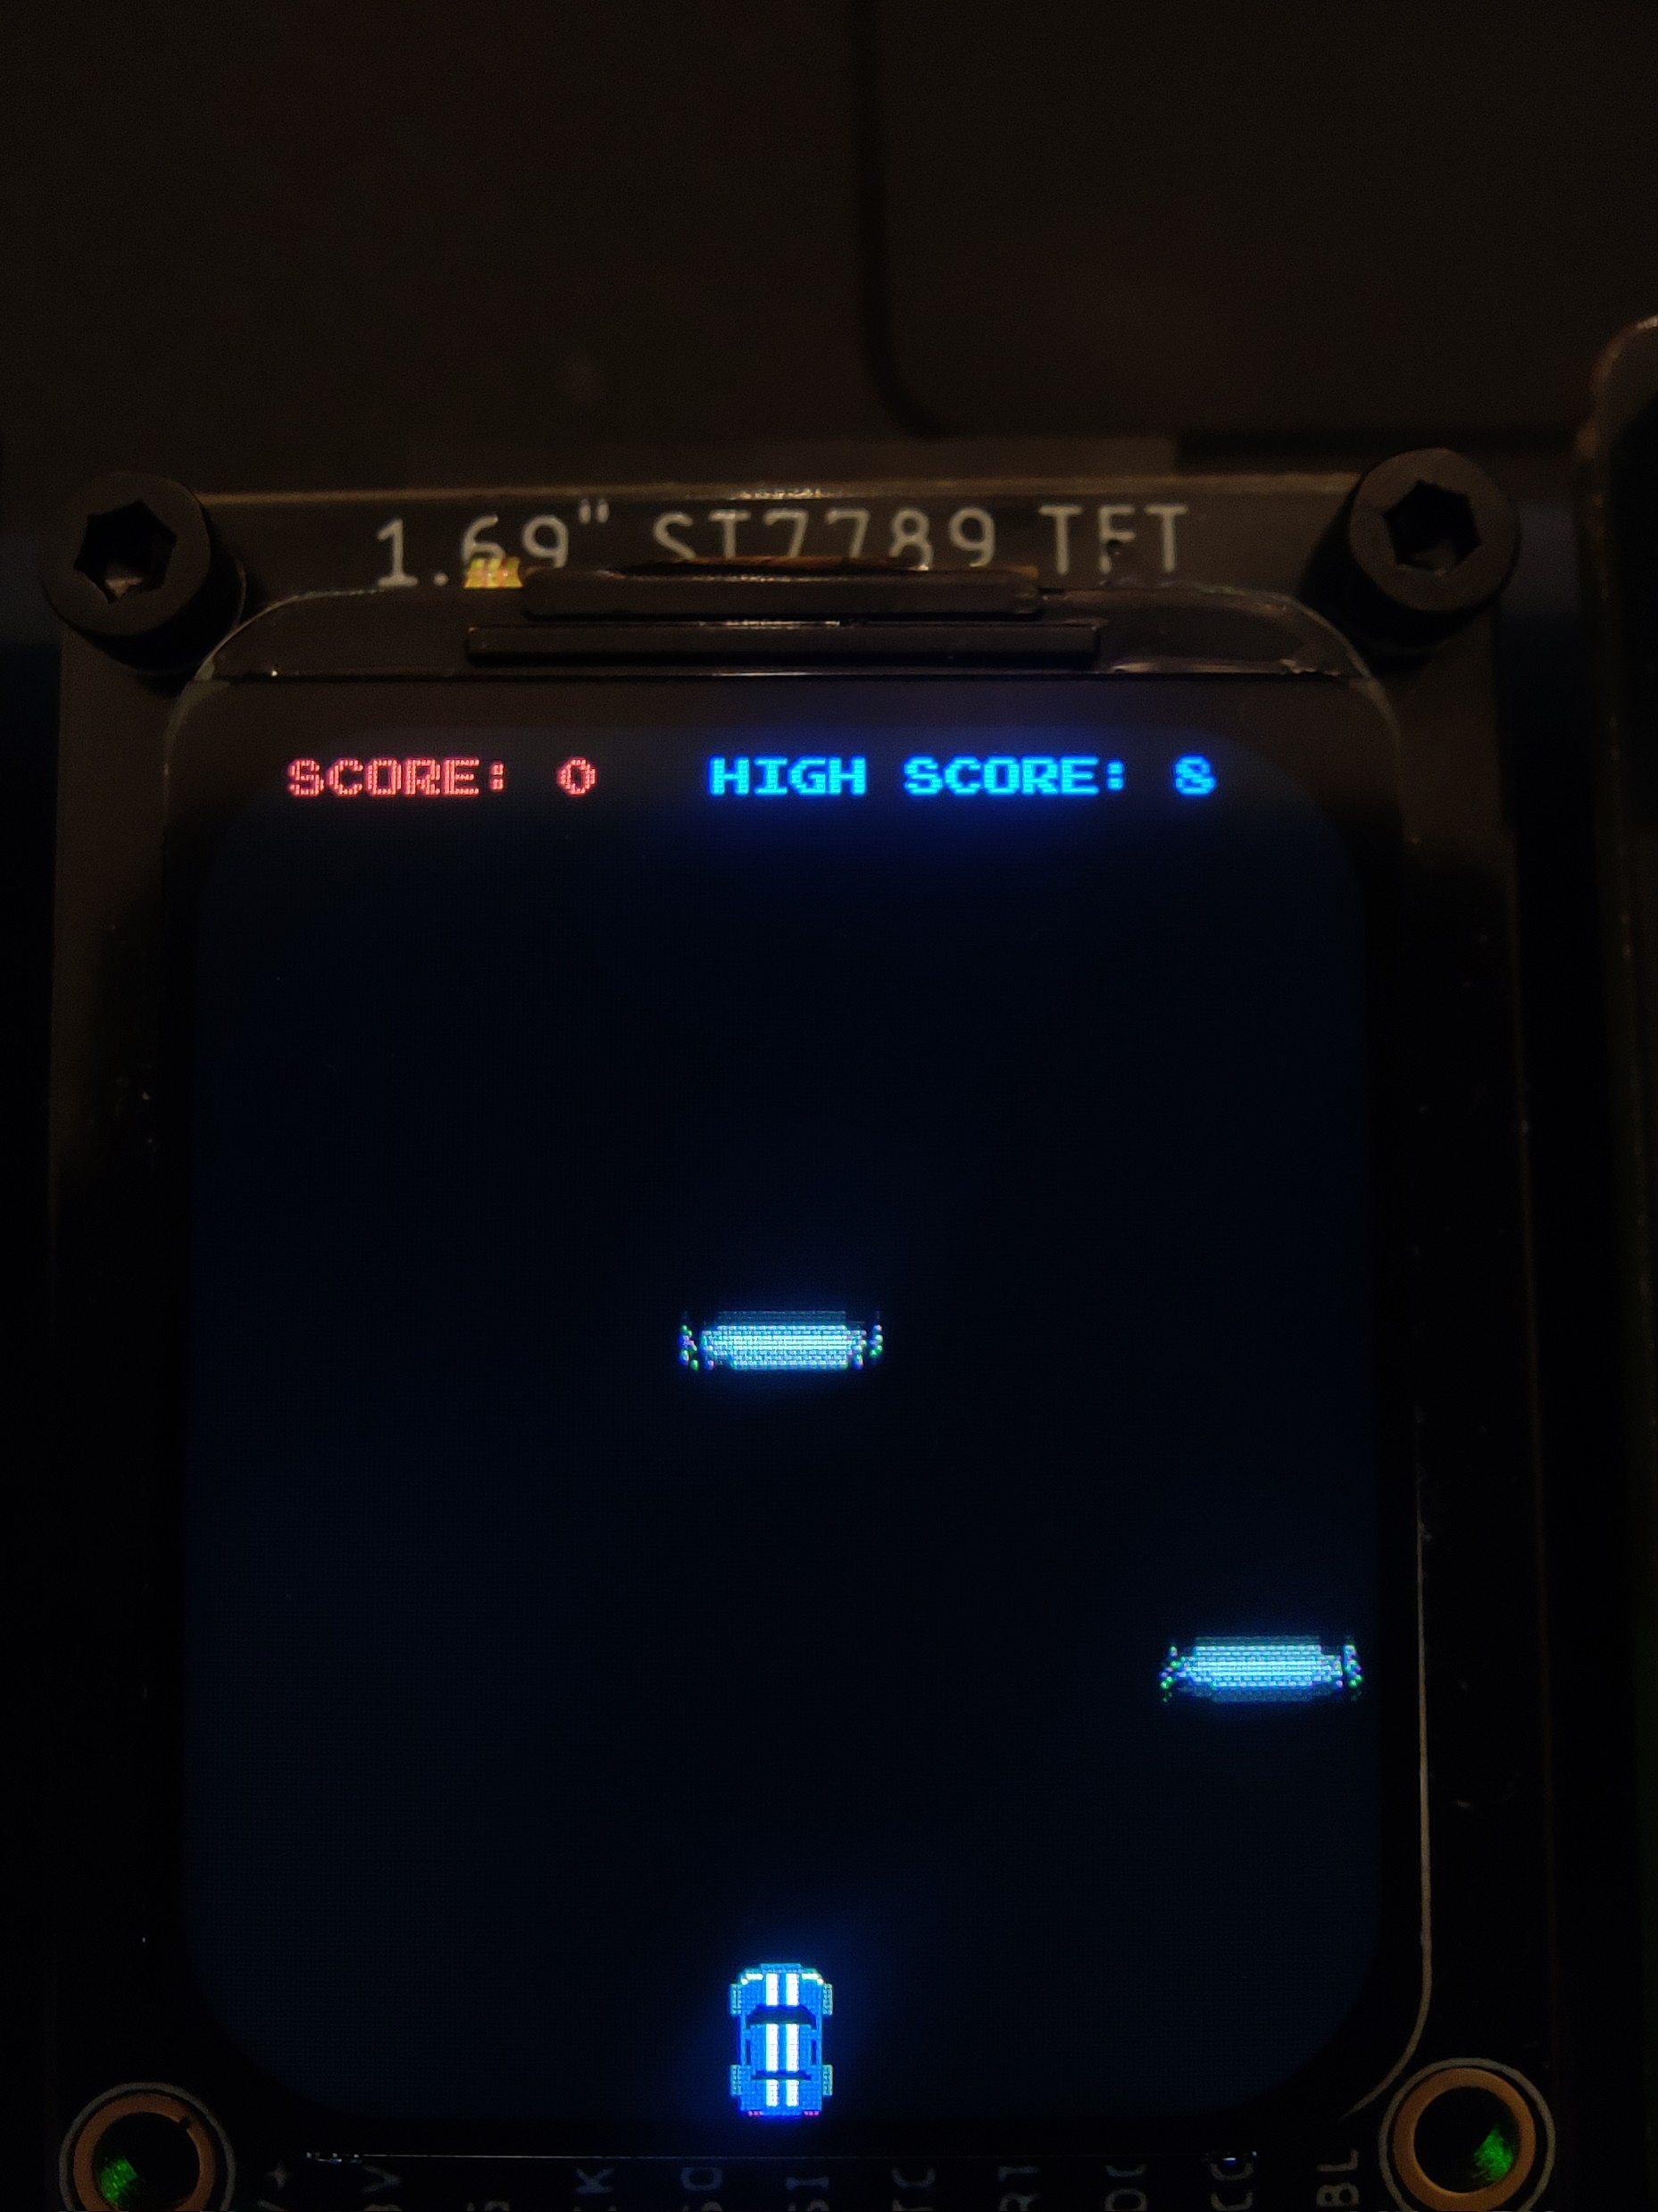
Idea vs Execution

Slide 6
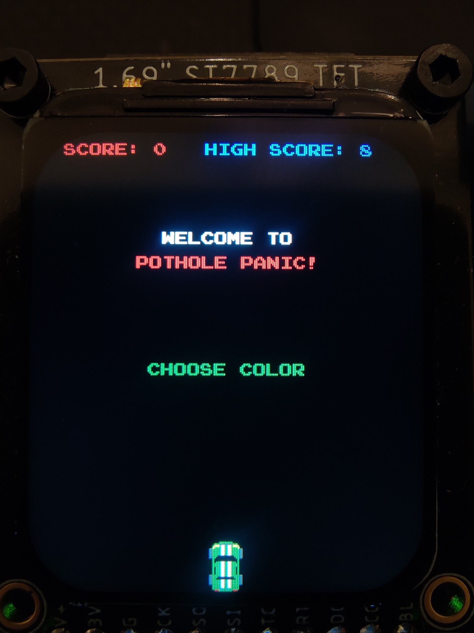
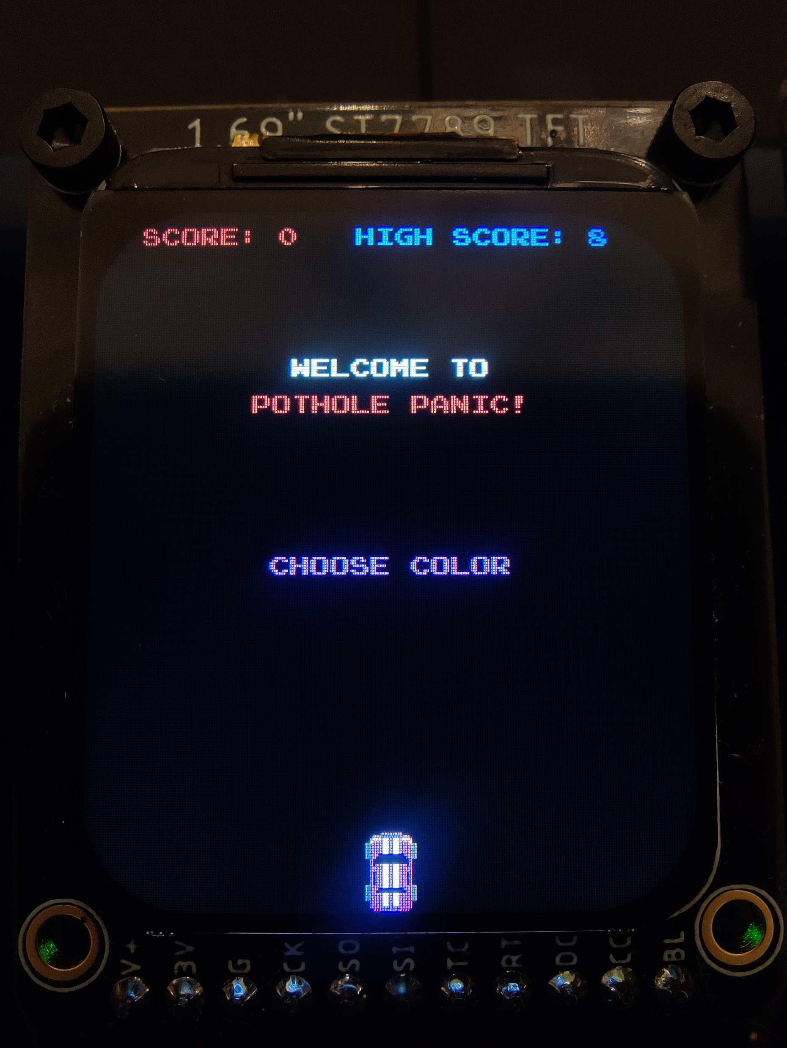
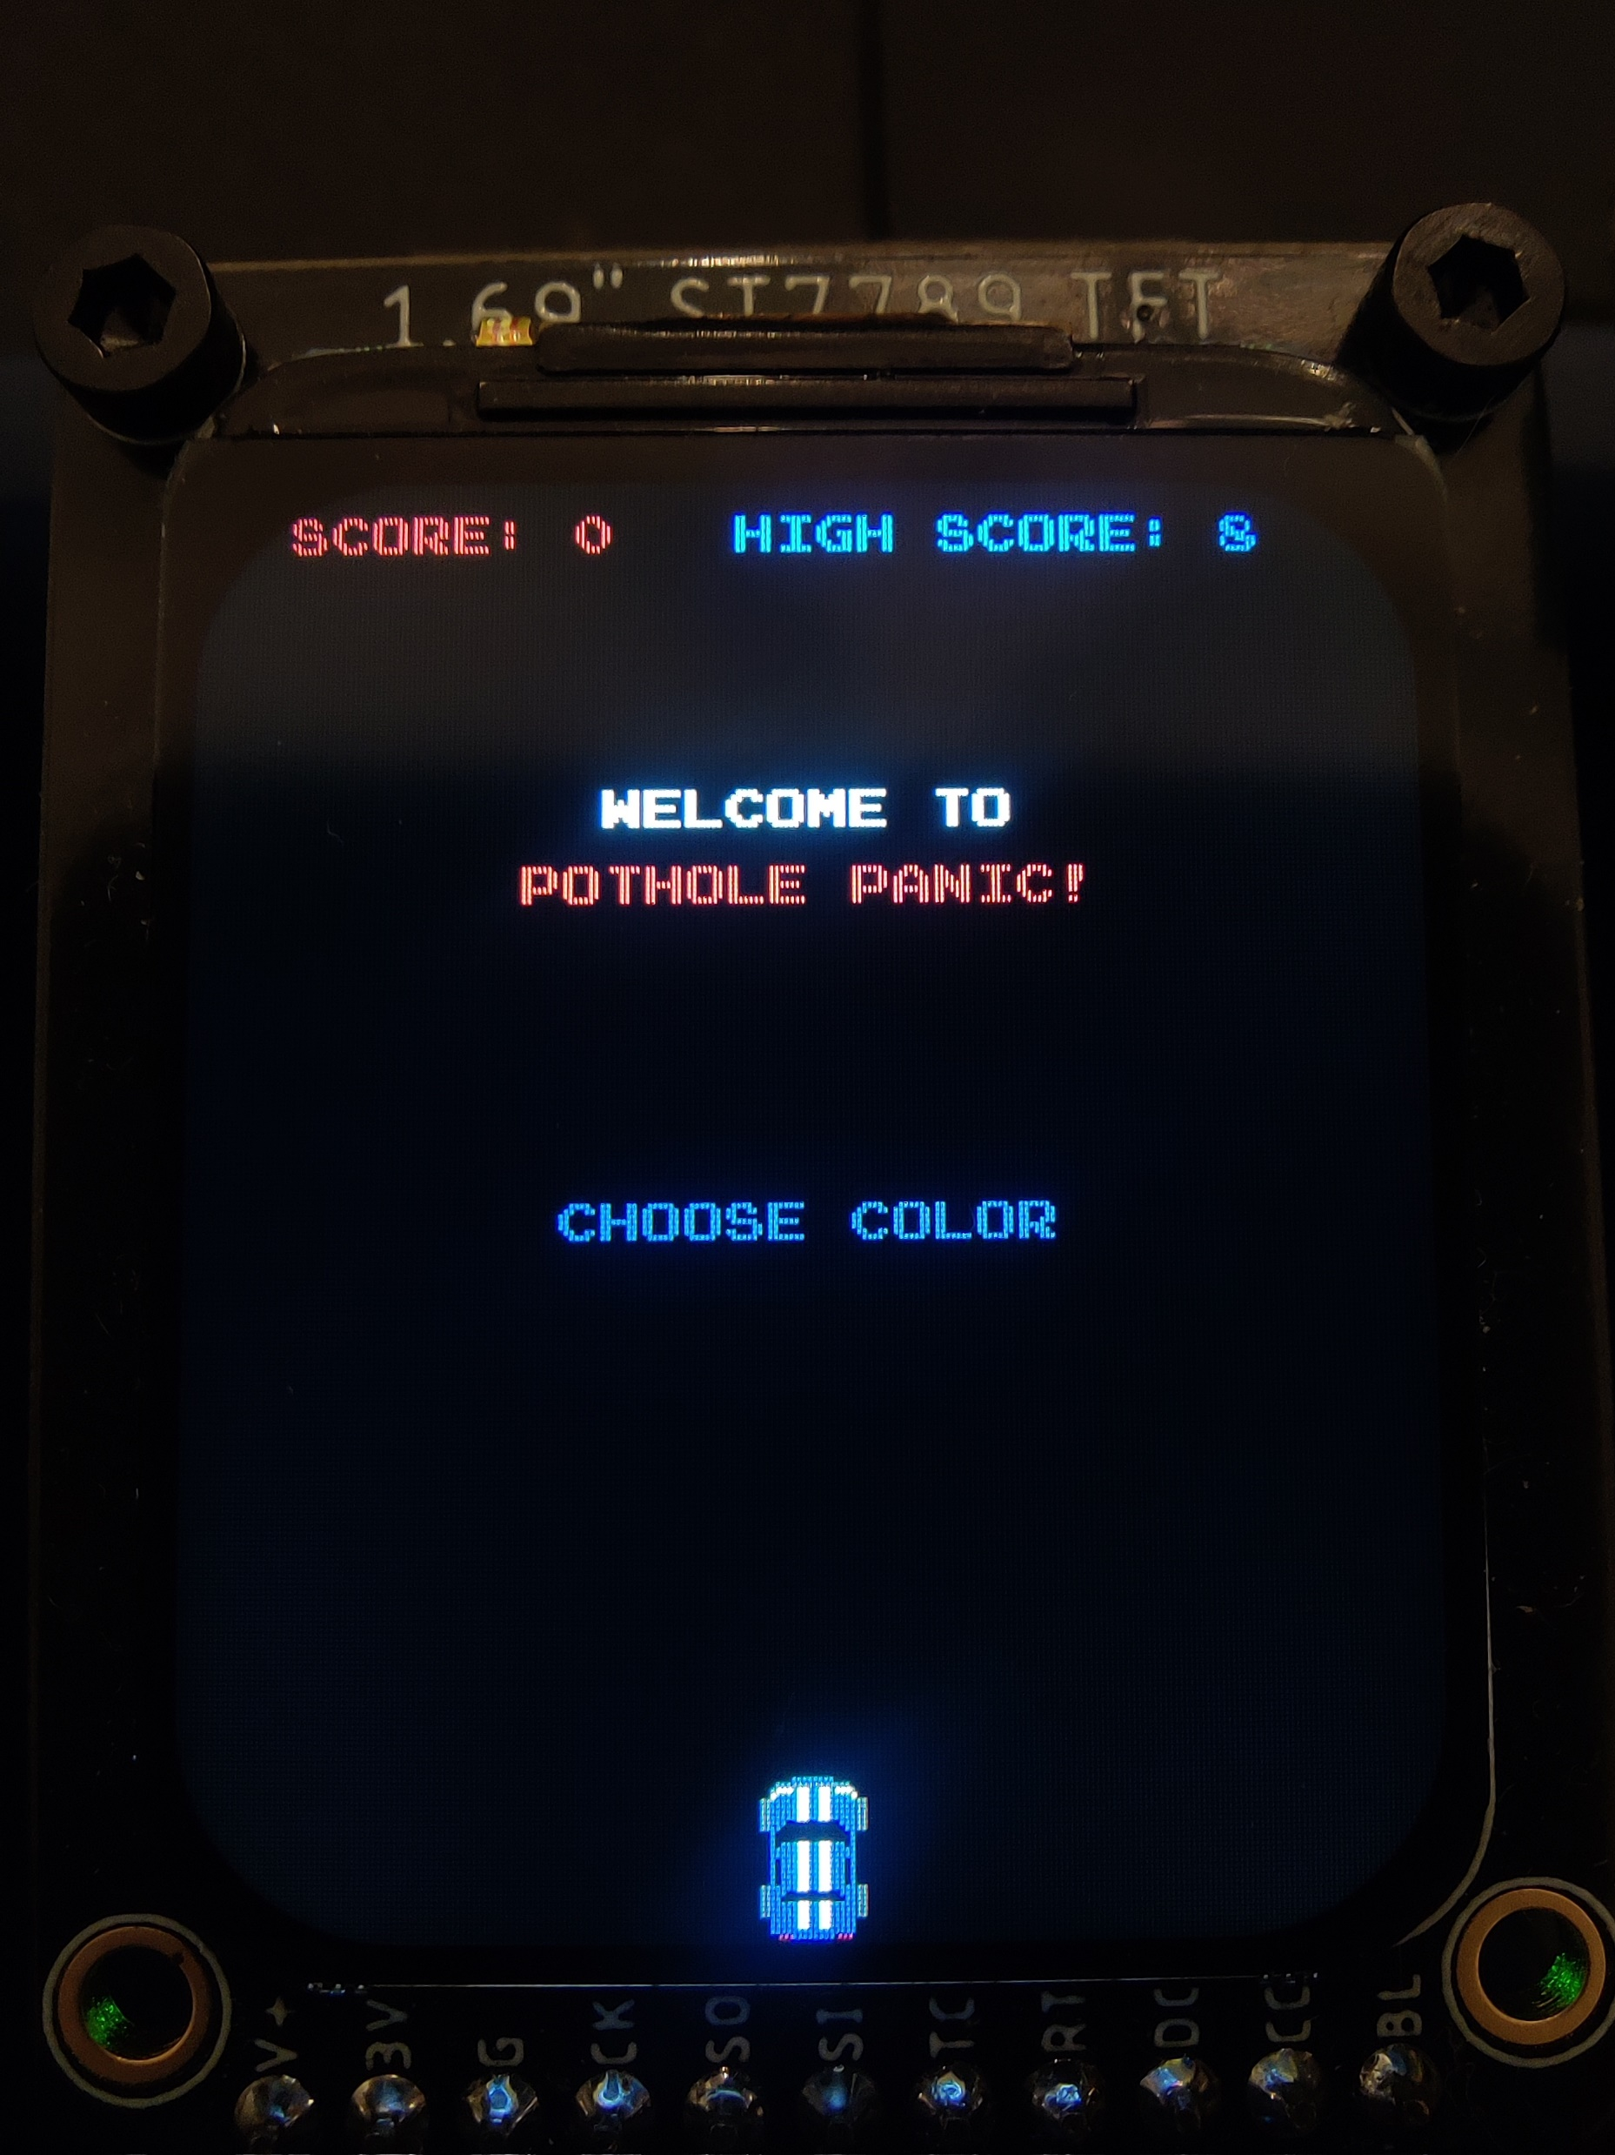
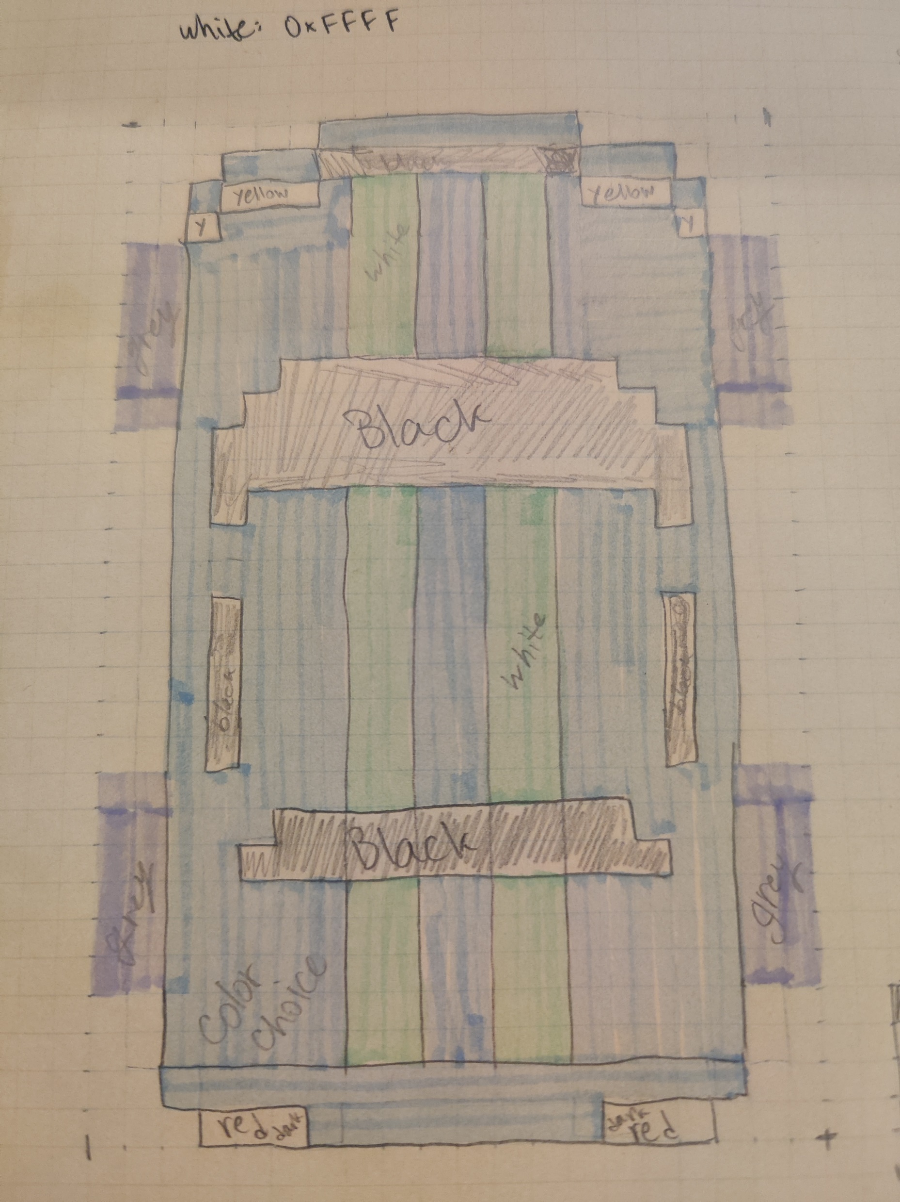
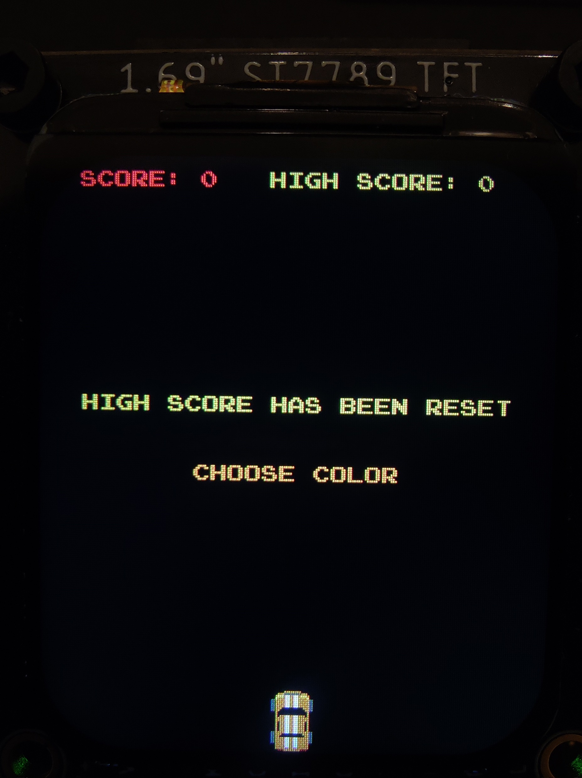
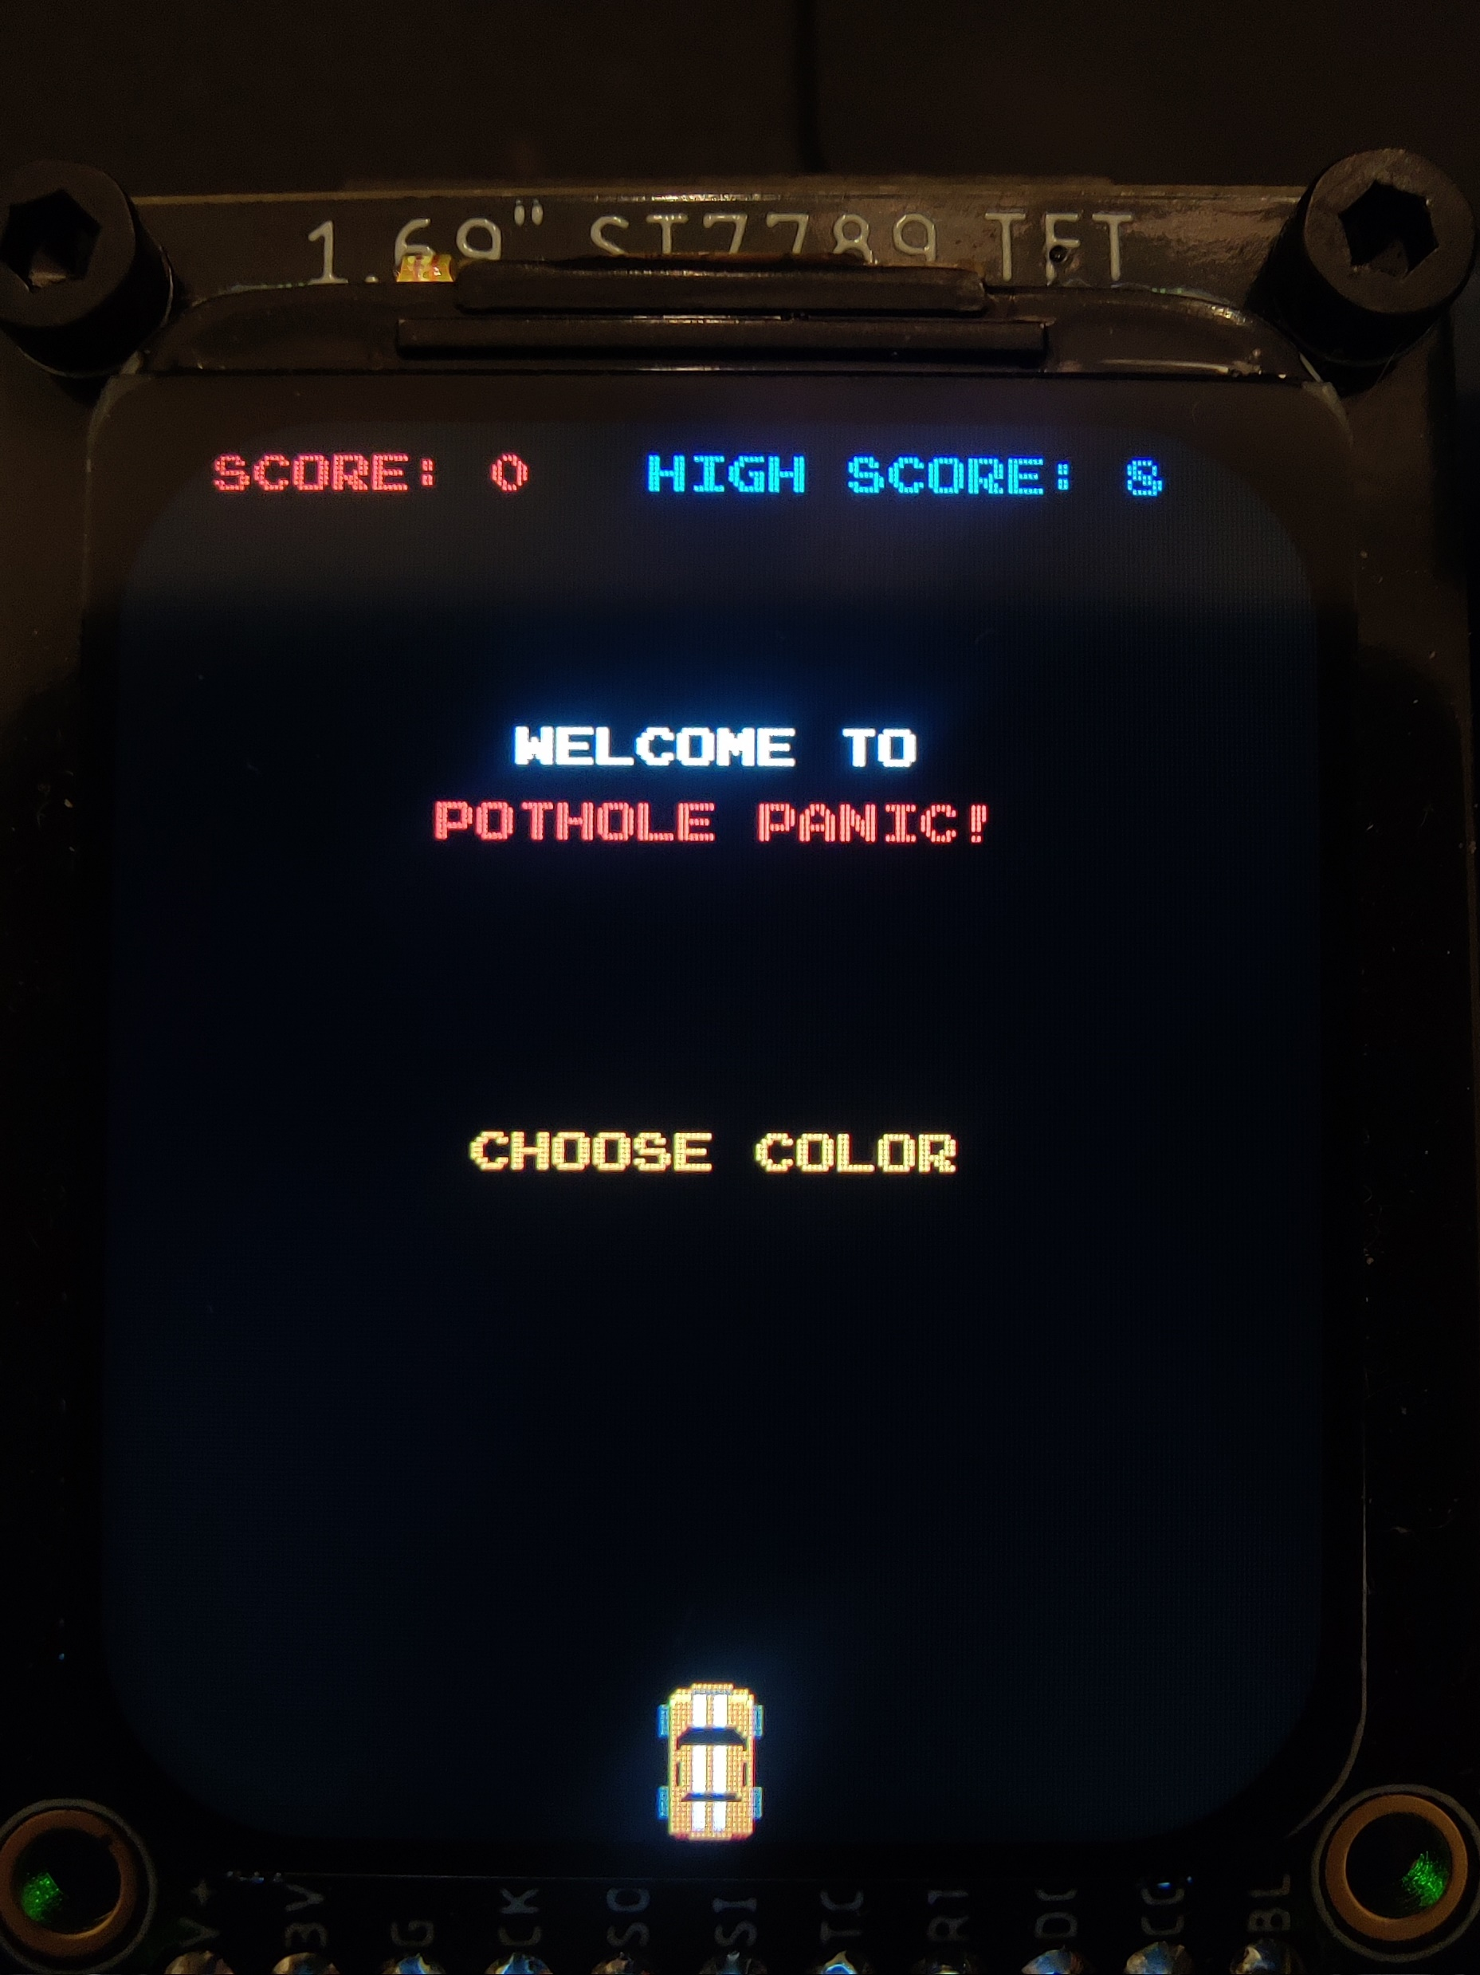
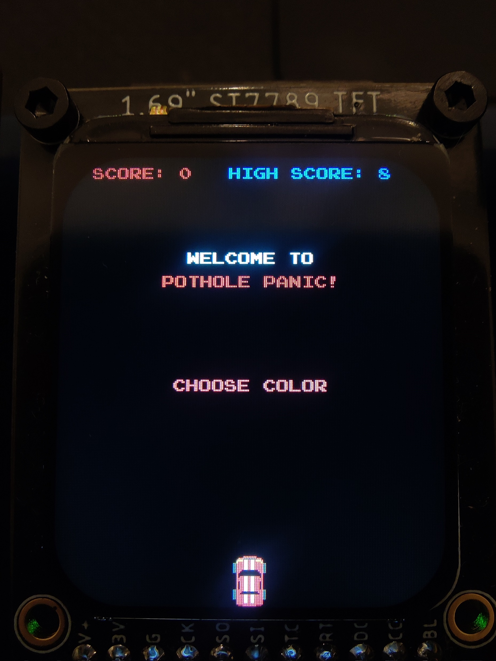
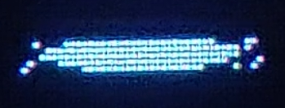
Idea vs Execution
Notes:
DEMO NEXT

Slide 7
What worked and What didn’t
Didn’t Work:
Movement was too slow and choppy
Fixed! Instead of erasing entire objects and redrawing, only erased sections that would not be drawn over
Method of controlling pothole speed was inconsistent and slow
Fixed! Instead of using delays to control speed, pothole position and speed is based on counter timer
Accelerometer data occasionally had bad data
Fixed! Ignored data values outside of a reasonable range
What Worked:
Car movement
Accelerometer movement algorithm worked with minor adjustment
Detecting Lose Condition
Overlapping pixels of the car with any pothole worked with no adjustment
High Score stored in EEPROM to persist through power cycles
Programming data to EEPROM and resetting with buttons worked with minor adjustment

Slide 8
Lessons Learned
The importance of the speed limitations of the SPI connection to the LCD
Stack size and max thread count limitations affect overall program speed
Understanding how to use timers in continuous counter mode
How to draw images on the LCD with arrays of pixels and its limitations
Adding threads and killing threads and when the best time to do it is
The importance of play testing

Slide 9
Possible Additions
Sound effects at start countdown, new high score, “you lose” screen, and at speed thresholds
Level indicators at speed thresholds
Pause button
More game complexity:
Additional playing modes
Adding coins or power-ups for the players to aim to hit for bonus points, special powers, etc.
Additional accelerometer axis for player speed control
Port to a higher performance platform (e.g. phone application)

Slide 10
THANK YOU

